Slide 1
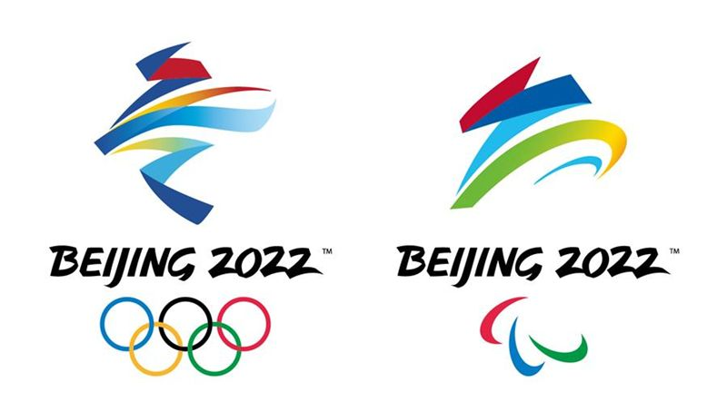
Winter Olympics Beijing Traffic Control
Jan. 17, 2022

Slide 2
Winter Olympics – Beijing Traffic Control Dedicated Traffic Lanes Activation
From Jan. 21, Winter Olympics dedicated traffic lanes of Beijing city will be formally activated. For details pls refer to https://baijiahao.baidu.com/s?id=1721894854547122355&wfr=spider&for=pc
Duration, Time, & Distance
- Winter Olympics: Jan. 21 to Feb, 25, total 36 days, 42 roads, 239.5km.
- Winter Paralympics: Feb. 26 to Mar. 16, total 19 days, 29 roads, 196.7km.
- Dedicated traffic lanes on Jingli Highway is activated for 24 hours, others are activated during 6:00 – 24:00.
Vehicles Permitted on Dedicated Traffic Lanes (with special permit released by Beijing Winter Olympics Committee)
- Passenger cars with special permit released by Beijing Winter Olympics Committee.
- Vehicles used for Winter Olympics relative luggage, equipment, & facilities transportation.
- Vehicles used to ensure Winter Olympics electricity & telecommunication supply, and relative emergency.
- Satellite broadcasting vehicles for Winter Olympic Games broadcasting.
- Trucks with capacity <4.5ton used for logistics, food & beverage, and waste cleaning.
- Vehicles used for opening & closing ceremony and rehearsal on certain days.
- Functional vehicles for emergency including police vans, fire engines, ambulances and engineering rescue vehicles.

Slide 3
Winter Olympics – Beijing Traffic Control Truck Restriction
Trucks from Other Provinces
From Jan. 30 to Feb. 20, from Mar. 1 to Mar. 13, only except for full trucks used for agriculture products & daily
necessities transportation, all trucks coming from other provinces should make a detour around Beijing city. For trucks
must enter in Beijing, Beijing Entry Permit needs to be applied and certain rules on the permit should be strictly
followed.
DG Trucks
From Jan. 30 to Feb. 20, from Mar. 1 to Mar. 13, all DG trucks are strictly forbidden in Beijing city. For DG trucks used
for daily life must enter in Beijing, trucks information should be registered and recorded by Beijing Transportation
Commission, Beijing Emergency Management Bureau, and Beijing Traffic Management Bureau, and drive on permitted
lanes. For trucks information recording & registration, pls refer to http://beian.zhihuihuoyun.cn
When Air Pollution
From Jan. 21 to Mar. 16, if any air pollution is predicted and actions should be taken, only except for vehicles used to
ensure normal city running, supporting Winter Olympics, public buses and new energy vehicles, all medium and heavy
trucks are not allowed to drive on road.

Slide 4
Winter Olympics – Beijing Traffic Control Key Roads Restricted in Beijing City (1)
From Dec. 26, 2021 to Mar. 31, 2022，only except for vehicles & people with special permit released by Beijing Winter Olympics Committee, others are all restricted to access.
2
1
Datun Road (Tianchene East Road to Beichen West Road)
1
2
Tianchen East Road (Kehui South Road to National Stadium North Road)
3
Tianchen West Road (National Stadium North Road to Datun Road）
3
4
National Stadium North Road (Beichen East Road to Beichen West Road）
5
Olympic Sports Center Middle Road (Beichen Road to Olympic Sports Center South Gate）
4
6
Continental Grand Hotel North (Beichen East Road to Crown Plaza East）
6
5

Slide 5
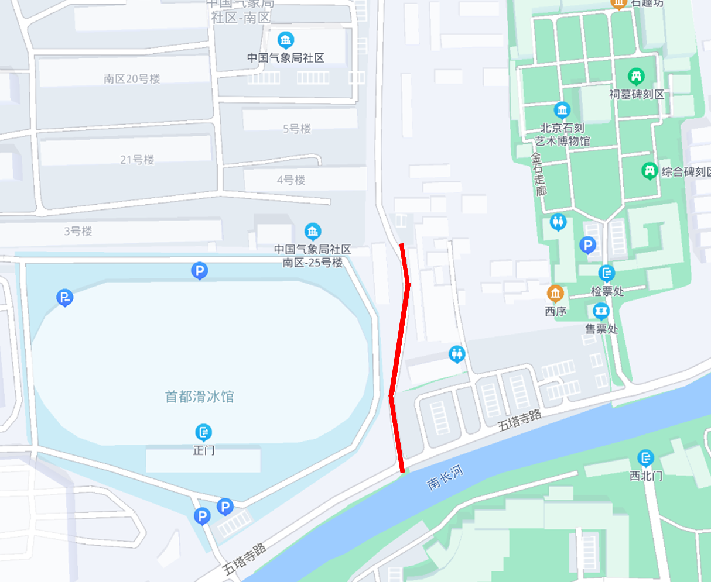
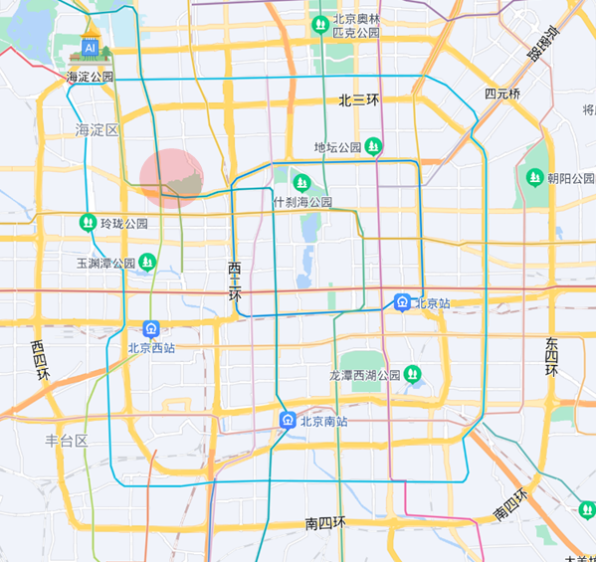
Winter Olympics – Beijing Traffic Control Key Roads Restricted in Beijing City (2)
From Jan. 27, to Feb. 23, during 6:00 to 2 hours after whole day matches are finished, only except for vehicles & people with special permit released by Beijing Winter Olympics Committee, others are all restricted to access.
1
Five-pagoda Temple Road
(Five-pagoda Temple Road to Stone carving Museum West）
1

Slide 6
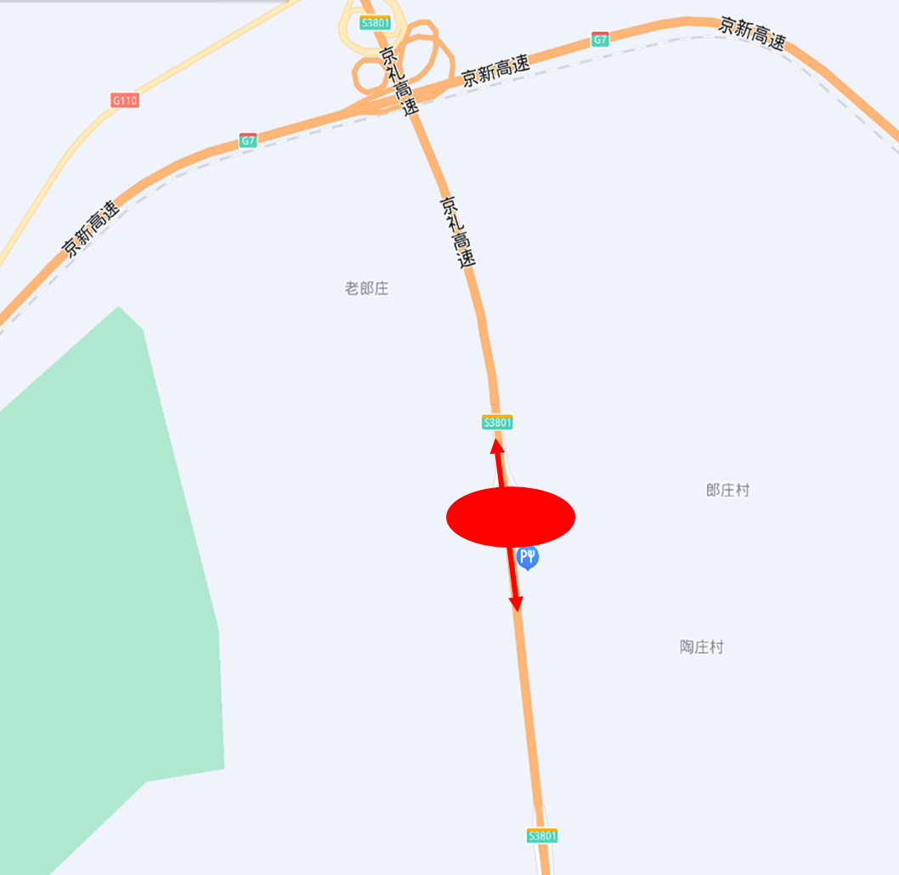
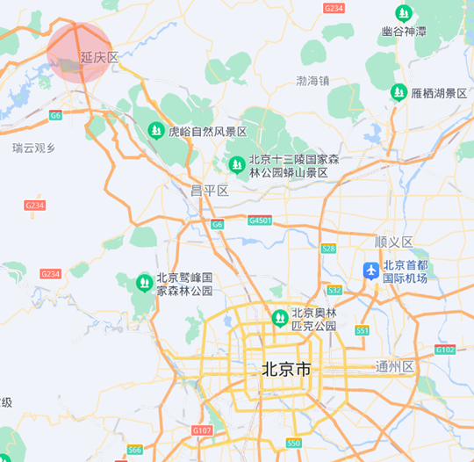
Winter Olympics – Beijing Traffic Control Key Roads Restricted on Jingli Highway (1)
From Jan. 4, to Mar. 16, only except for vehicles & people with special permit released by Beijing Winter Olympics Committee, others are all restricted to access.
1
Jingli Highway Banquan Service Area
(Bi-direction of in/out Beijing city and on/off ramps)
1

Slide 7
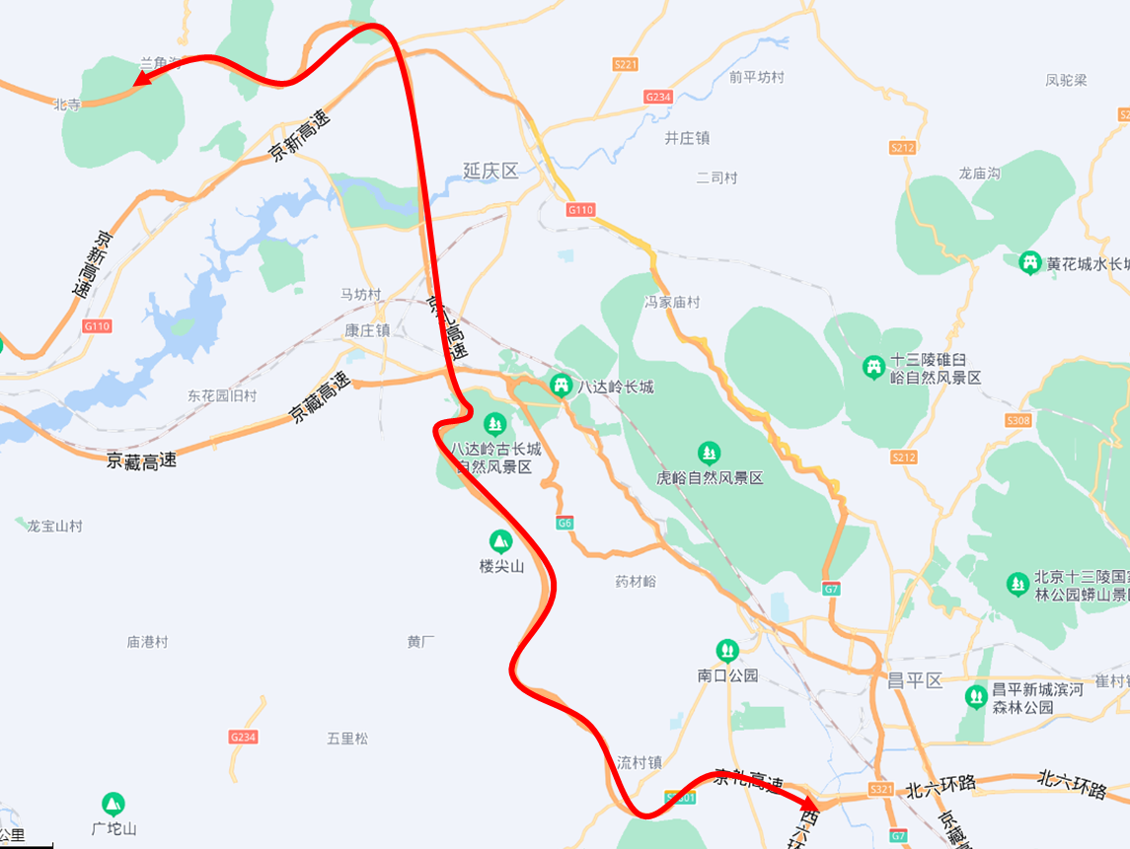
Winter Olympics – Beijing Traffic Control Key Roads Restricted on Jingli Highway (2)
From Jan. 21 to Mar. 16, only except for full trucks used for agriculture products & daily necessities transportation, all trucks with capacity >4ton are not allowed to access.
1
Jingli Highway
(Bi-direction between 6th Ring Road and Beijing city border)
1

Slide 8
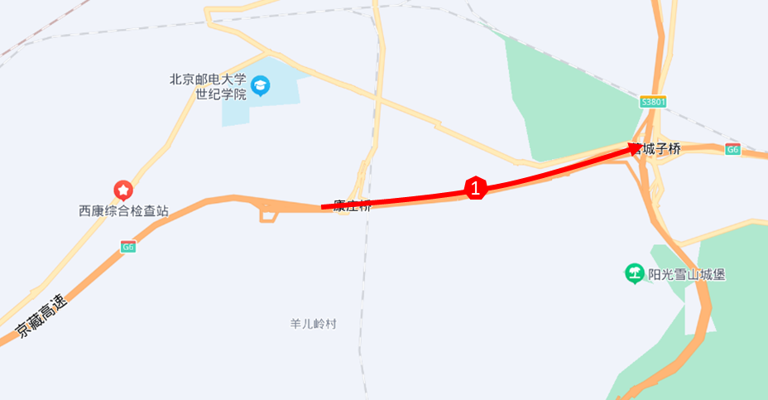
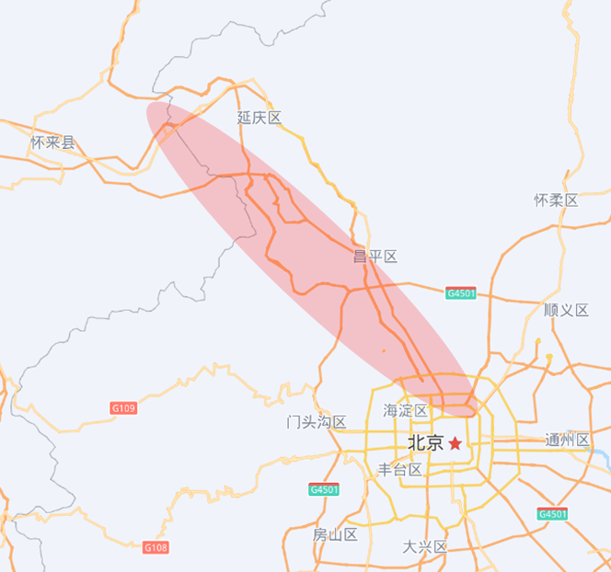
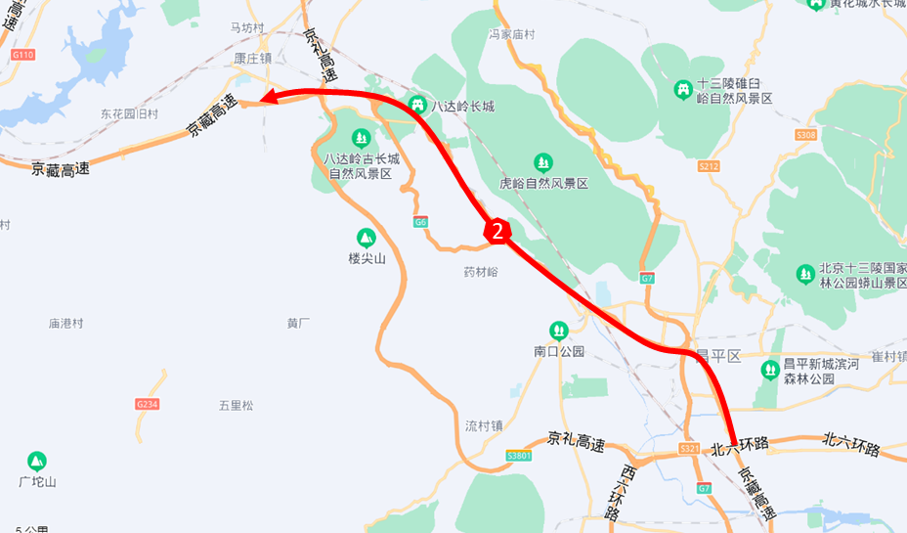
Winter Olympics – Beijing Traffic Control Key Roads Restricted on Jingzang Highway
From Jan. 21 to Mar. 16, only except for full trucks used for agriculture products & daily necessities transportation, all trucks with capacity >4ton are not allowed to access.
1
Jingzang Highway
(single direction from Beijing city border to Yingchengzi Overpass, 24 hours)
2
Jingzang Highway
(single direction from 6th Ring Road to Beijing city border, during 6:00 - 24:00)

